Slide 1
Software Quality Assurance
Pavithra Subashini
Senior lecturer
Faculty of Computing

Slide 2
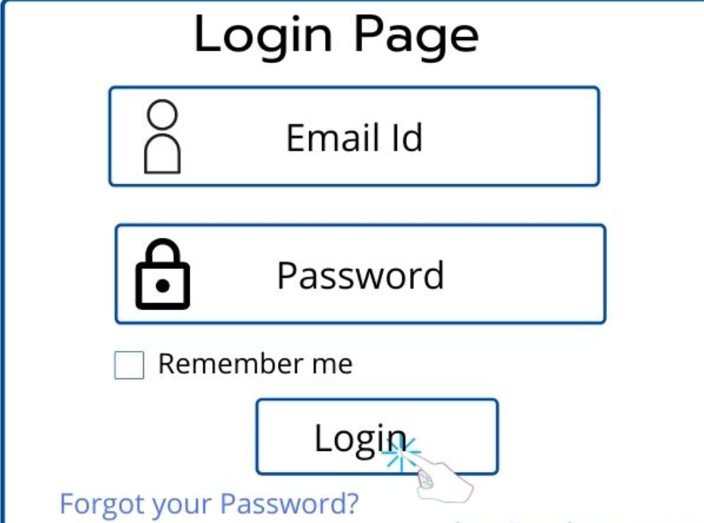
Activity
Write test cases

